Slide 1
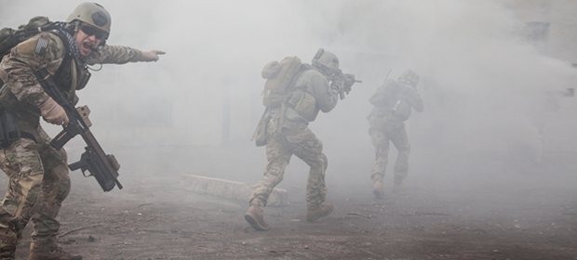
Fog of War
Ferran Martín Vilà

Slide 2
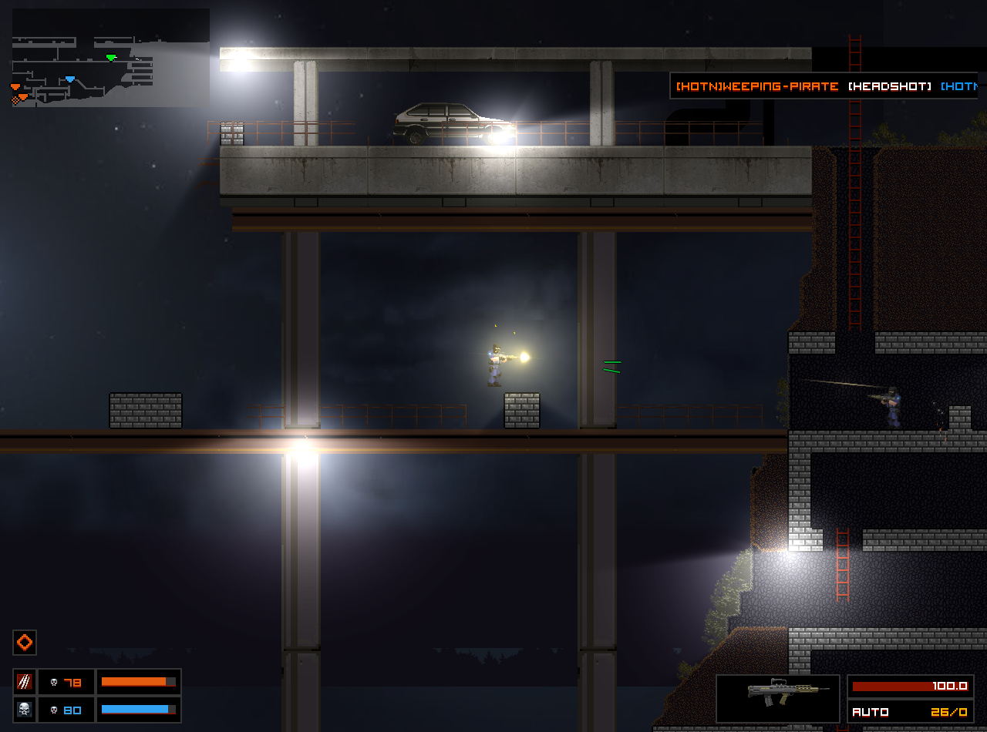
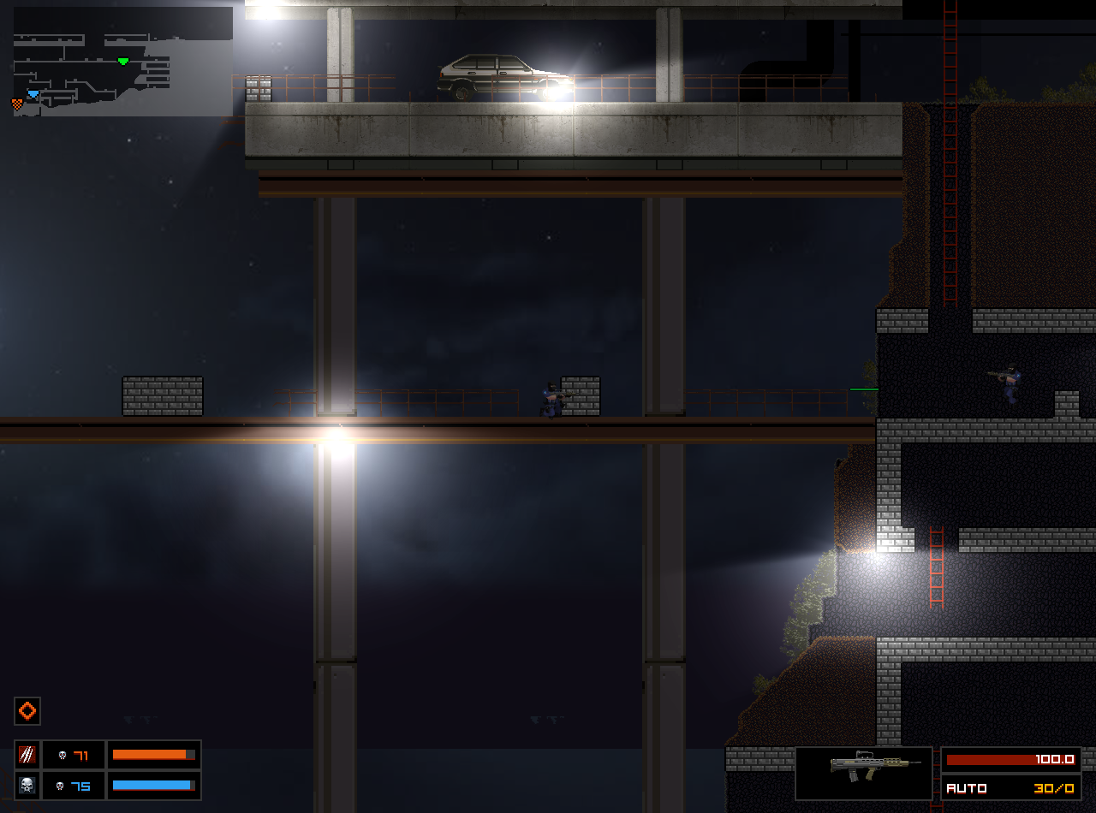

Concept:
Fog of war is not fog ?

Slide 3
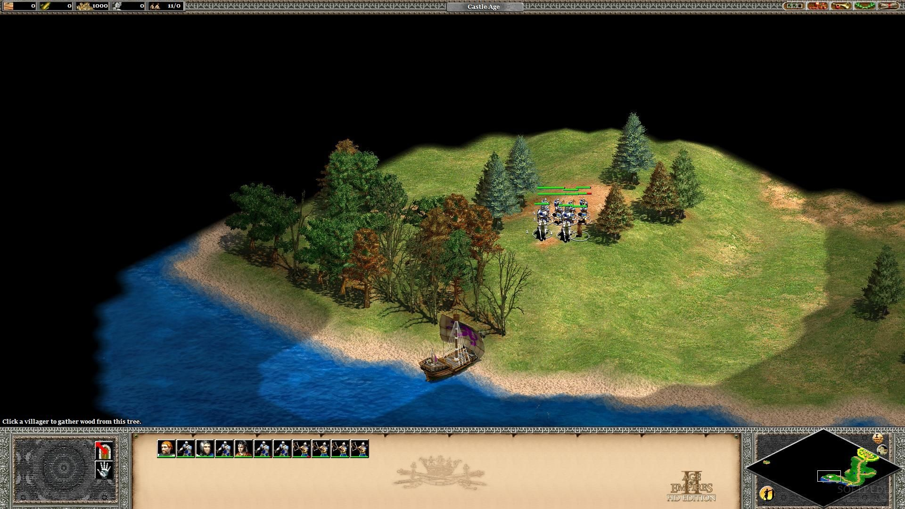
Types:
- Grand Strategic: We don’t know anything about the enemy.

Slide 4
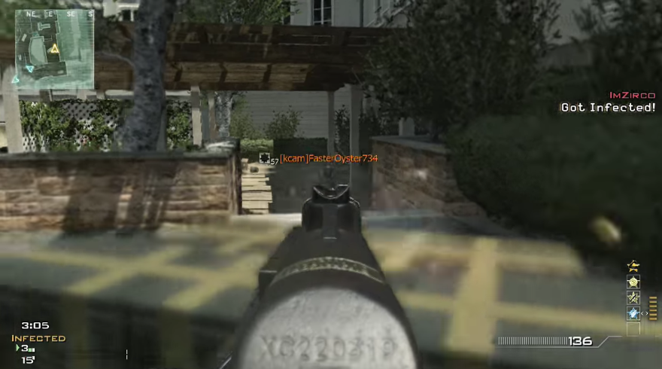
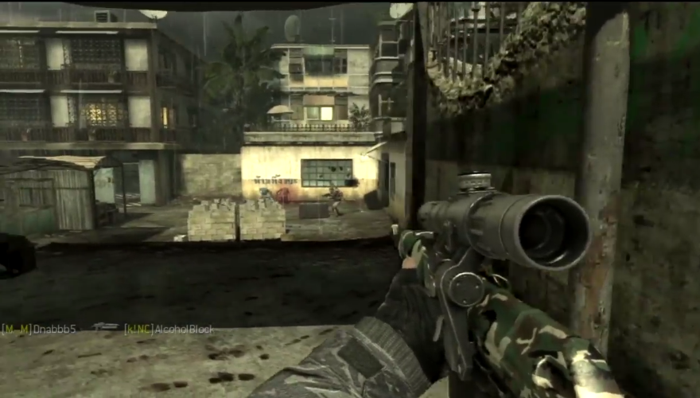
- Military Strategic: Ambiguity in strength and disposition.

Slide 5
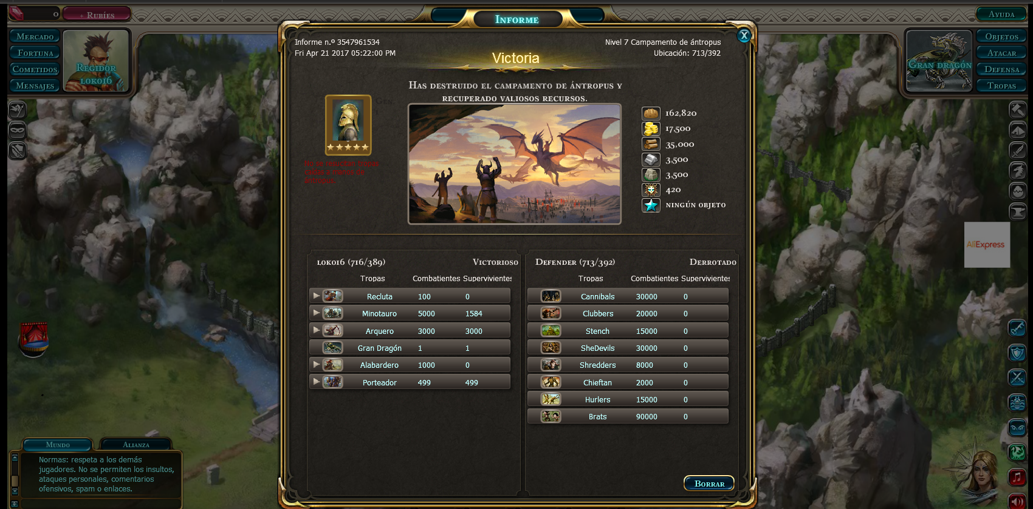
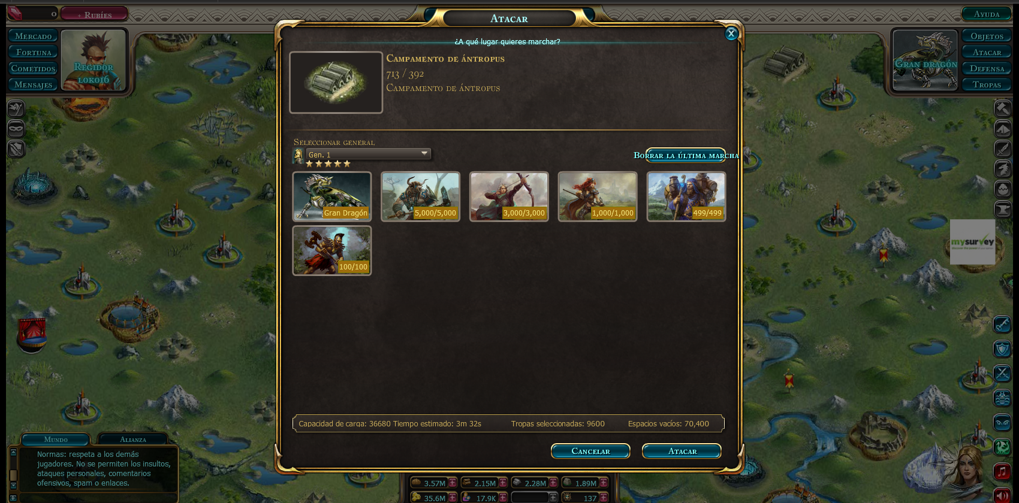
- Operational: Own directive ambiguity.

Slide 6
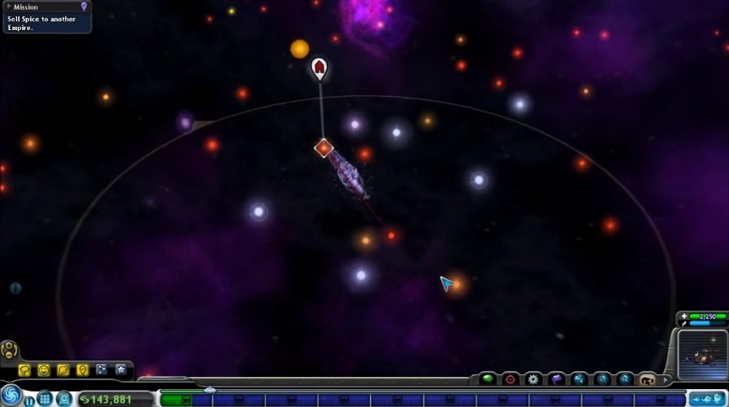
- Tactical: Lost of contact.

Slide 7
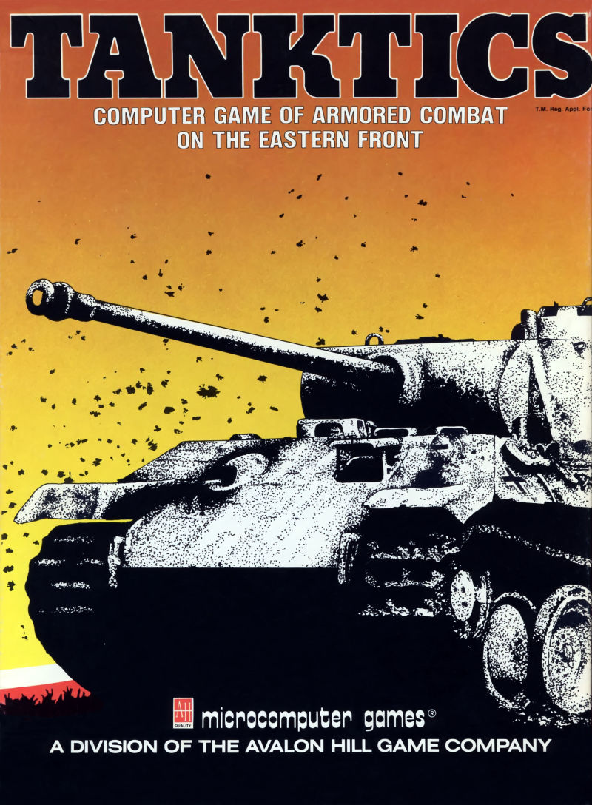
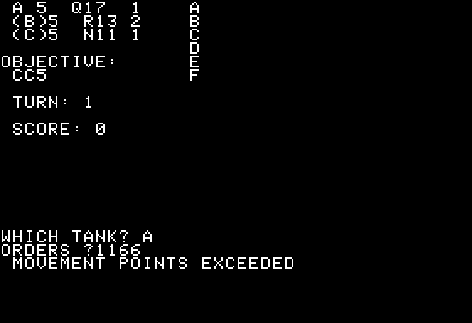
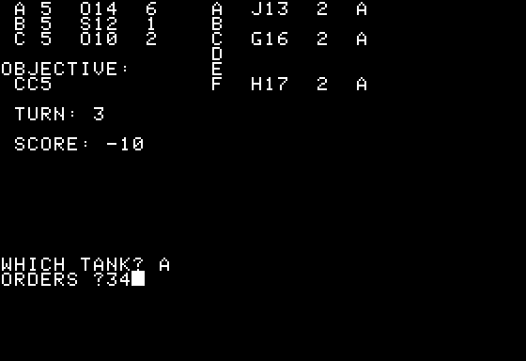
- Origins:
- First game with fog of war!

Slide 8
Todo 1
Create fog layer! (logic layer)

Slide 9
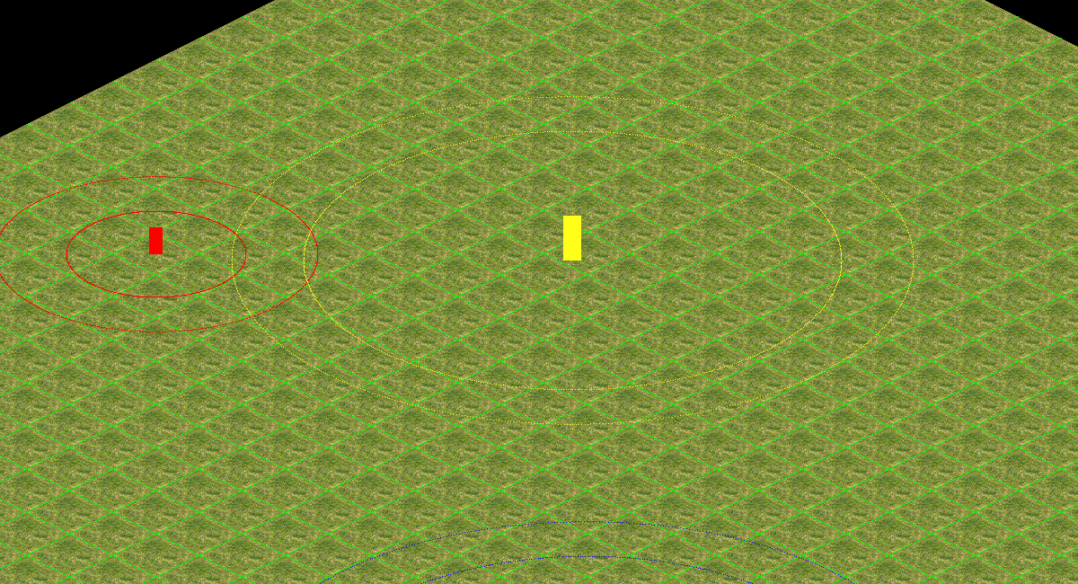
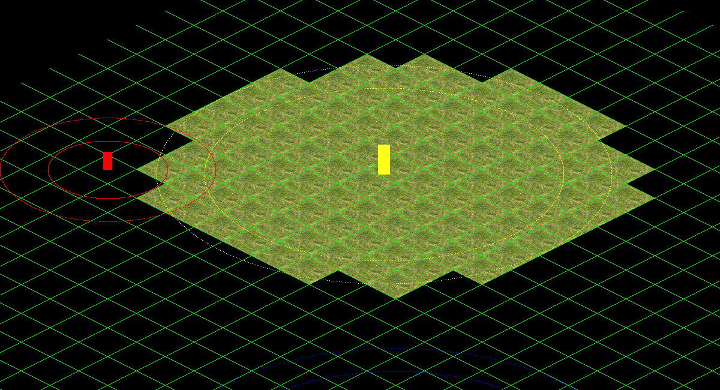
Todo 2
- Map Optimization!
If a tile is under DARK_FOG don’t render it!

Slide 10
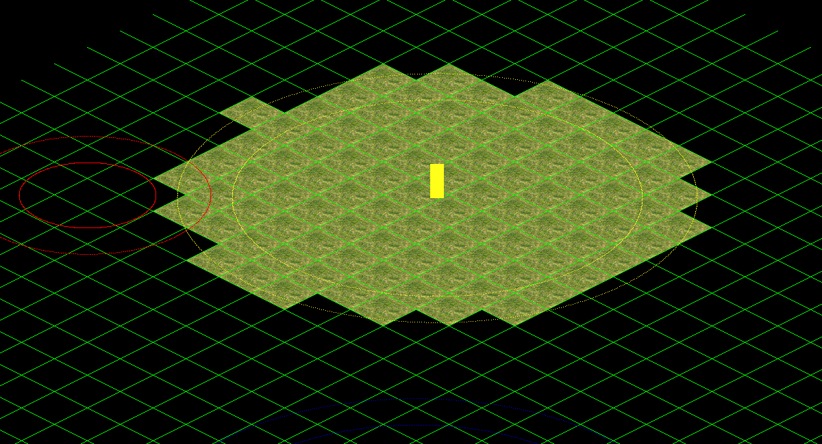
Todo 3
- Entities draw optimization!

Slide 11
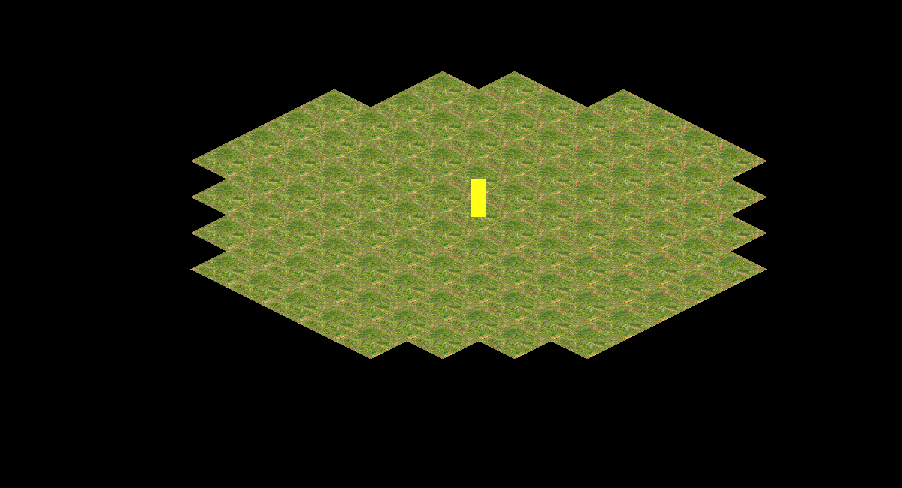

Todo 4
Draw alpha layer!
Use app debug mode to actívate/deactivate the fog draw

Slide 12
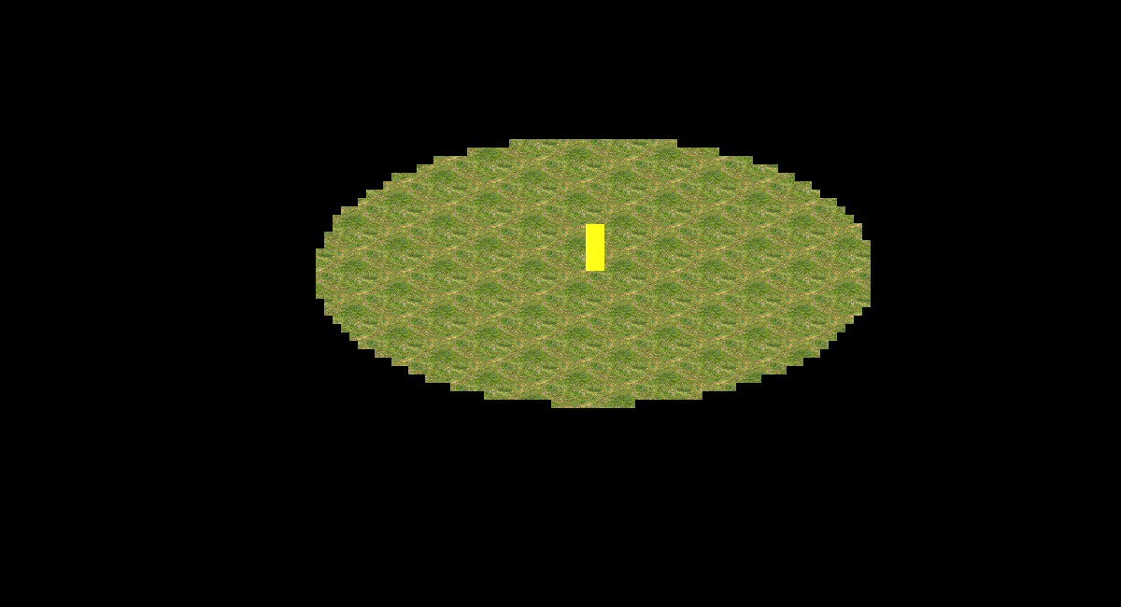
Todo 5
- Make ally entities clear alpha layer!

Slide 13
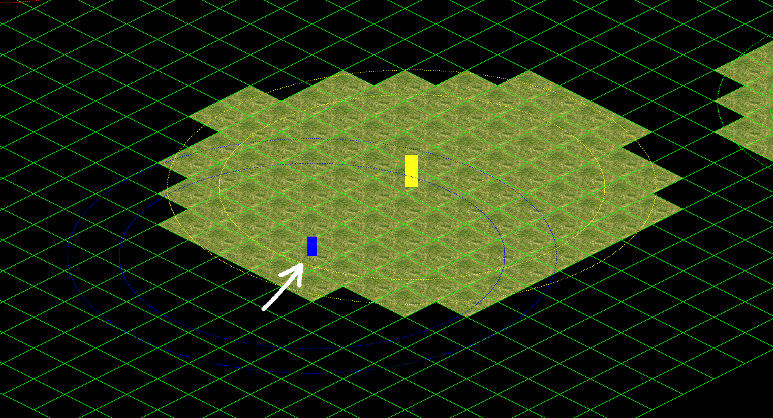
Todo 6
Make player check his vision area!
Fill CheckVisionArea entity method and call it from player update.

Slide 14
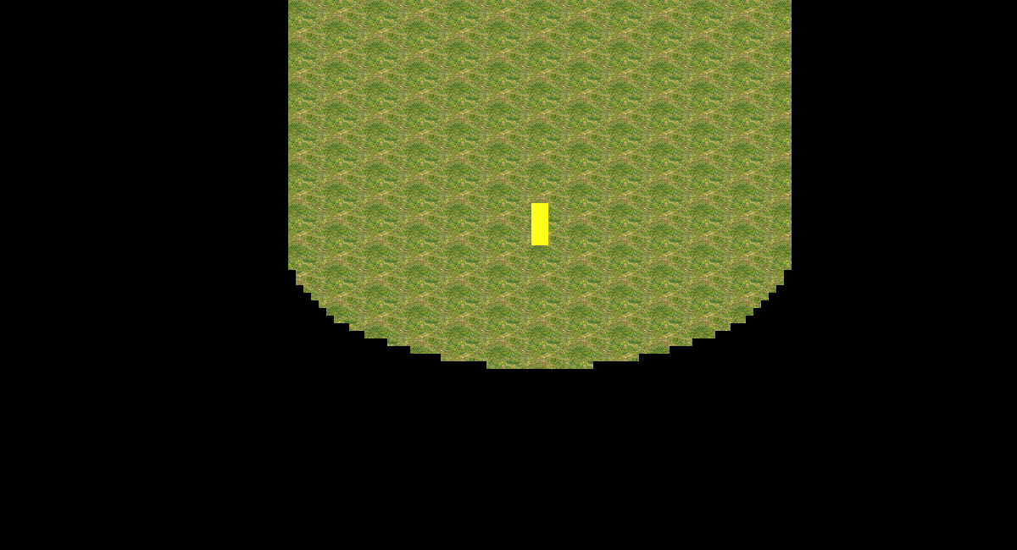
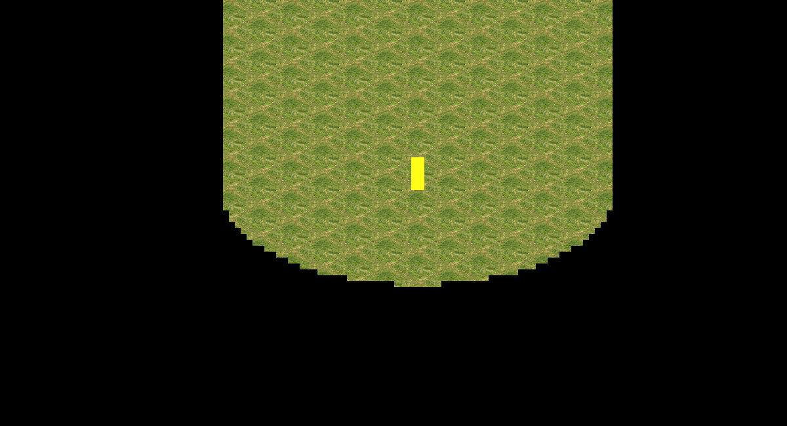
Todo 7
- Clear fog area when a neutral entity is detected!

Slide 15
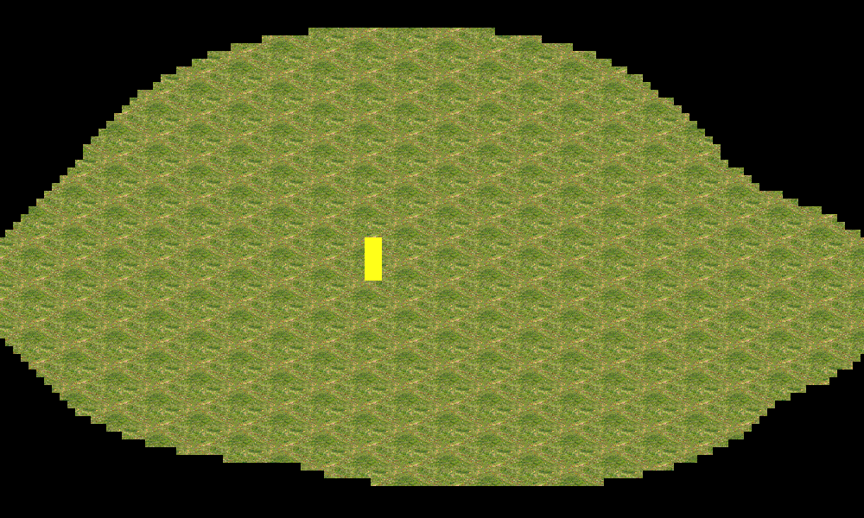
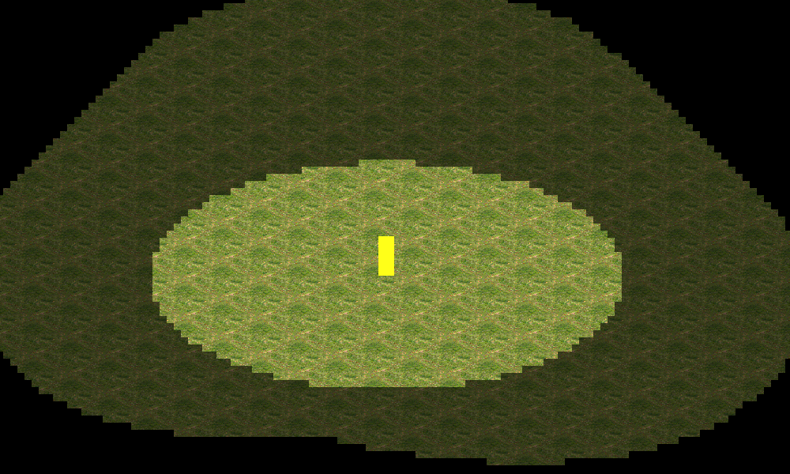
Todo 8
- Update alpha layer!

Slide 16

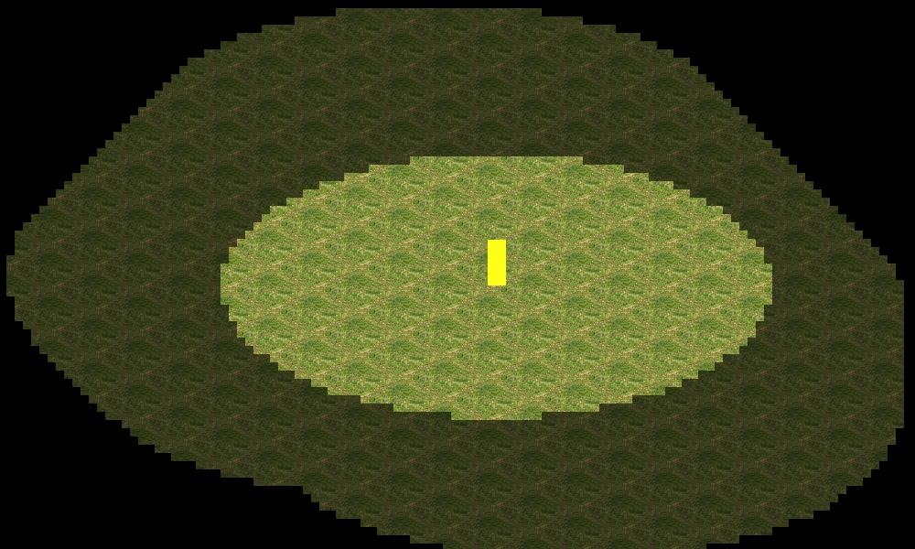
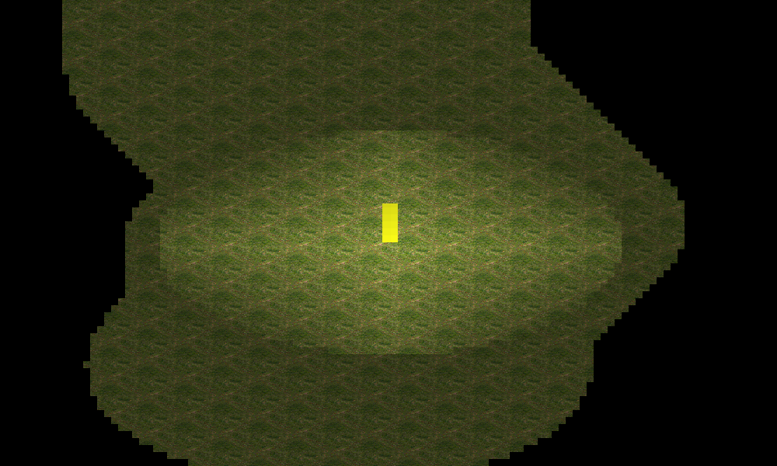
Extra Work!
- Create a function to smooth the fog alpha layer and iterate it!

Slide 17
More Info…

Slide 18

And that's it!
Contact me!
GitHub: https://github.com/ferranmartinvila
Gmail: ferranmartinvila21@gmail.com

